Slide 1

NPACE 2026
Email, Social Media & Content Capabilities
Best Practices & Content Submission Guidelines

Slide 2
ABOUT THIS GUIDE
Thank you for considering a partnership with NPACE!
We’re excited about the opportunity to collaborate and connect with our audience on your behalf.
This guide outlines NPACE’s capabilities in Email Marketing, Social Media Engagement, and Content Creation.
Please take a moment to review the information provided. Doing so will help streamline the development, approval, and distribution process for your email campaigns, social media posts, and other content opportunities.

Slide 3
ABOUT NPACE
NPACE is a national nonprofit organization committed to advancing excellence in patient care.
We do this by delivering high quality, evidence-based educational programs tailored specifically for Nurse Practitioners and Physician Assistants in a rapidly changing healthcare environment.
Our curriculum is thoughtfully designed by Advanced Practice Providers, for APPs, ensuring that every course is relevant, practical, and aligned with the evolving needs of today’s healthcare environment. We focus on emerging topics in primary care and pharmacology, keeping our learners ahead of the curve.
By engaging with the NPACE audience, you gain access to a vibrant community of NPs and PAs who are passionate about lifelong learning and clinical excellence.

Slide 4
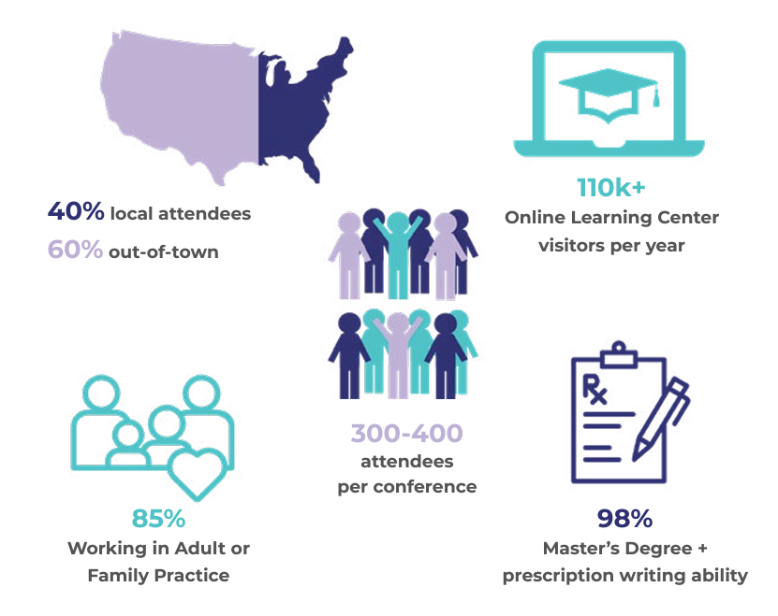
NPACE DEMOGRAPHICS
NPACE percentage breakdown on specialties: (NPACE reaches approx. 120K NPs through marketing and communication channels)
75% - Adult/Family Practice (90,000)
8.6% - Acute Care (10,300)
5.6% - Geriatric/Palliative Care (6,750)
2.8% - Psych/Mental Health (3,360)
2.7% - Pediatric (3,240)
2.2% - Women’s Health (2,650)
1.7% - Oncology (2,050)
1.4% - Other (Dermatology, Orthopedic, Radiology, Cardiology, Surgical, etc) (1,700)

Slide 5
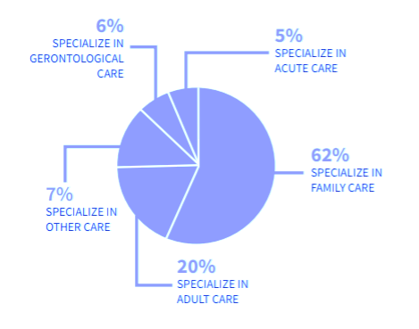
NPACE DEMOGRAPHICS

Slide 6
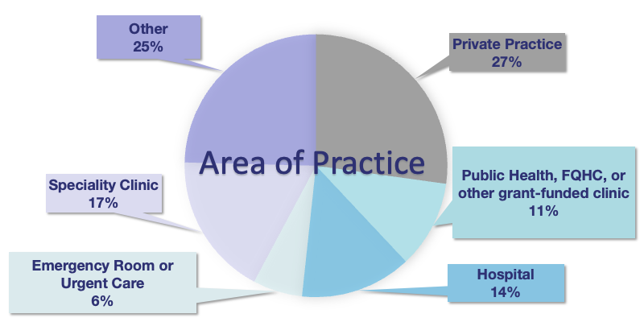
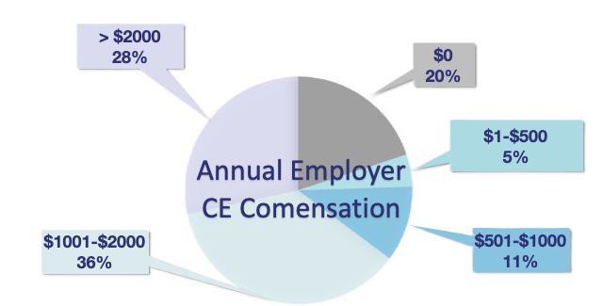
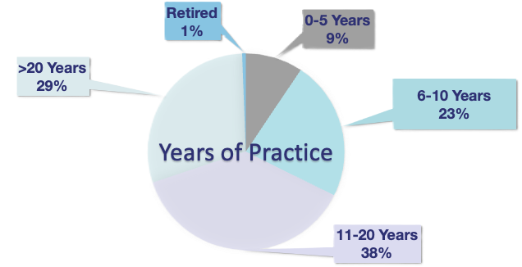
NPACE NEEDS ASSESSMENT
Each year, NPACE conducts a needs assessment to learn more about our APPs and see what interests they have. We use this information to help guide our decisions for what to bring to conferences.
MEET THE AUDIENCE:

Slide 7
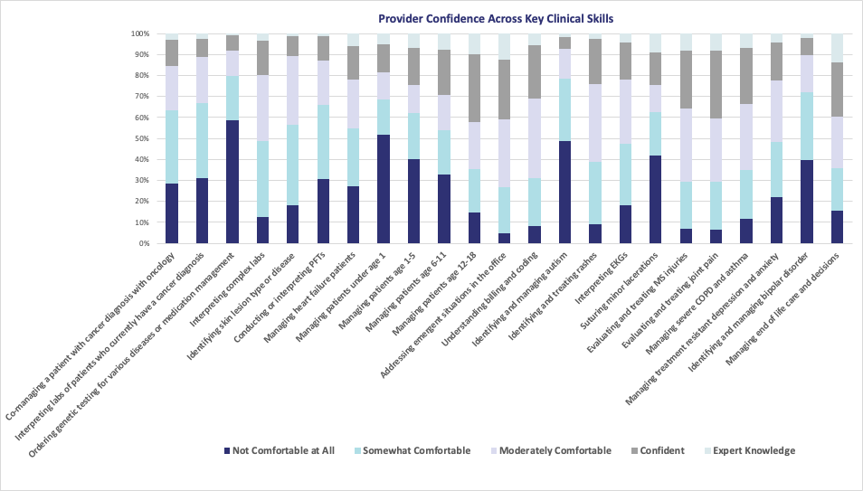
NPACE NEEDS ASSESSMENT
CONTINUED

Slide 8
CAPABILITIES
Program Opportunities
In-Person/Virtual and On-Demand Hosting
A/V Solutions
Recording/Editing
Pre/Post Tests
Evaluations
Q&A
Reporting on Data/Analytics/Performance
In-Person Events
CE & Non-CE Programs
Lead Retrieval
Hands on Trainings
Poster Sessions
Exhibit Booths
Focus Groups
Receptions/Networking
Onsite & Offsite Meal Programs
Private Meeting Space
Signage
Flyers
Multi-Media
Emails
Social Media Posts
Website Landing Pages
Virtual Program Hosting
Newsletter
Podcasts
Event/Opportunity Promotion
Segmented Targeting

Slide 9
NPACE REACH
Emails​
95,000 - Nurse Practitioners Receive NPACE Email Communications​
20-25% - Open Rate​
2-5% - Click-To-Open Rate​
Social Media Following​
Facebook – 8,500​
Instagram – 2,400​
LinkedIn – 1,400​
Twitter – 489 ​
Tik-Tok - 390​
​
Website Traffic​
​Total Unique Site Visitors: 1,362,956
Total Unique User Page Views: 1,723,141
*As of 9/10/25​

Slide 10
WEBSITE & LEARNING CENTER REACH
NPACE Website (NPACE.org)
2,100 daily page views to NPACE.org homepage
  63,000 monthly page views
  750,000 annual page views
60 daily visitors to NPACE media page where blog and podcast live
  1,600 monthly page views
  16,400 annual page views
NPACE Learning Center (Learn.NPACE.org)
Annual Stats:
Total Users: 12,180
Unique Site Visitors: 410,000
Total Unique User Page Views: 475,000
Registrations: 13,500
Credits Earned: 14,250

Slide 11
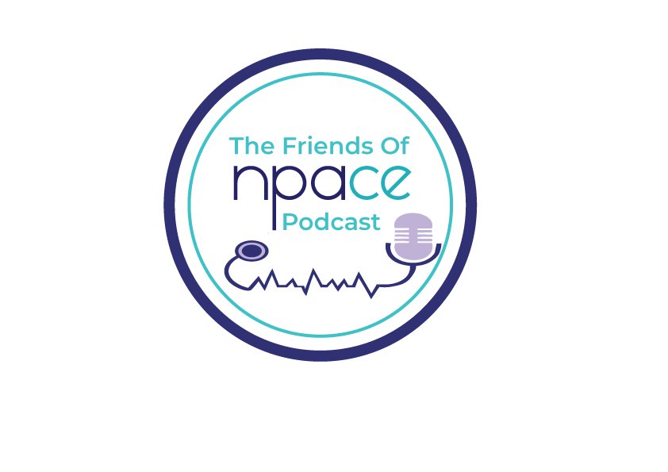
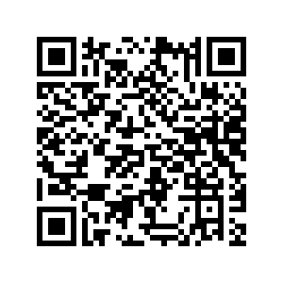
FRIENDS OF NPACE PODCAST REACH
Podcast Listenership (Since Jan 2024)
NPACE Learning Center – 575
YouTube – 3,200
Apple/Spotify – 3,025
Total Podcast Downloads – 6,800
Social Media Metrics (Video Content):
TikTok – Avg: 1,900
Facebook – Reach 1600-2000 per post
Instagram – 300-400 views
SCAN HERE TO LISTEN

Slide 12
EMAIL REACH & STATS PROVIDED
Delivery Rate – 99.9%
Total Delivered – 100,000 (Approx)
Total HTML Opens (20-25K)
Unique HTML Opens (18-22K)
Open Rate (17-24%)
Total Clicks (500-700)
Click thru Rate (1%)
Click to Open Ratio (1-2%)
Full Click Report on total clicks provided for each URL embedded in email

Slide 13
ADDITIONAL CAPABAILTIES
To learn more about NPACE capabilities, in addition to reviewing this slide-deck, we highly recommend scheduling a 15-30-min introductory call with our team to explore opportunities further and answer any questions you may have.
To book a call, please contact Josh Plotkin, NPACE COO, and Emily Eddins, NPACE Business Development Coordinator.
jplotkin@npace.org
774-279-4607
eeddins@npace.org
774-270-5445

Slide 14
GUIDELINES
The following slides provide detailed guidelines for collaborating with NPACE across various media channels.
From email and social media to custom content, we offer dynamic ways to connect with our engaged community of NPs and PAs.
Please review the information carefully, and don’t hesitate to reach out with any questions or to explore opportunities that align with your goals.

Slide 15

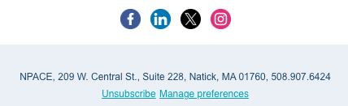
BRANDED EMAIL MESSAGING
You're welcome to create a custom email tailored to your message and goals. NPACE will distribute the email to our database on your behalf and provide performance metrics within 48–72 hours after the send.
Key Details:
All emails will include the standard NPACE footer (see example on the right).
Your content will be placed within the format shown in the sample provided.
Please submit both HTML and PDF versions of your email.
Include your preferred subject line and desired send date/time.

Slide 16
EXPORTING HTML & TESTING
As a small team ourselves, we understand that not everyone has the time or expertise to create pixel-perfect HTML emails. Many of our sponsors choose to build their emails within their own email marketing platforms before sharing them with us, and that works just fine!
If you're designing within your own system, please be sure to test your email across multiple browsers and email clients to ensure it displays correctly and provides a smooth user experience.
If you're unsure how to export HTML from your platform, we've included helpful guides below for some of the most commonly used email marketing tools.
Mailchimp, ActiveCampaign, Hubspot, SendGrid, Klaviyo, AWeber, iContact.
NPACE will send a test message to your team prior to the send date/time.

Slide 17


REMOVING UNSUBSCRIBE LINKS
Before submitting your HTML email to NPACE, please remove any unsubscribe links associated with your organization.
NPACE uses a unique unsubscribe link tied to our database to manage opt-outs effectively.
While unsubscribe requests are rare, including multiple unsubscribe links can lead to confusion and may prevent users from successfully opting out.
Ensuring a single, consistent unsubscribe option helps maintain clarity and protects the user experience.

Slide 18

EMAIL FONTS
We understand that your brand guidelines may require the use of specific fonts in your marketing communications, and we’ll do our best to accommodate those preferences.
However, we strongly recommend using web-safe fonts whenever possible to ensure consistent rendering across email clients and devices.
If you choose to use custom fonts, please be sure to include fallback fonts in your CSS. This ensures that your message remains readable and visually aligned with your brand—even if the custom font isn’t supported by the recipient’s email client.

Slide 19
SOCIAL MEDIA POST GUIDELINES
A social media post with NPACE will allow your company to access over 10,000 followers on the NPACE social media accounts (Facebook, Twitter, Instagram, TikTok and LinkedIn)
Post Submission Guidelines
Text- 280 characters for Twitter, and up to 500 characters for LinkedIn, Instagram, and Facebook
Headline- 25 characters
Link Description/CTA- 30 characters
URL Link (please shorten if possible)
Image/Video Guidelines
Twitter- 1024 x 512px
LinkedIn- 1200 x 628px
Instagram & Facebook- 1080 x 1080px
Tik-Tok – MP4 Video size 9:16, 1080x1920px

Slide 20
INSTAGRAM & FACEBOOK STORY
Purchasing an Instagram and Facebook story post will allow your company to reach over 11,000 Nurse Practitioners with a dedicated 24-hour story on the NPACE Instagram and Facebook Accounts.
All Instagram stories are saved as highlights on the NPACE Instagram account to be accessed after the 24-hour story post period. Your Instagram Story Ads can be videos or images.
Video Requirements for Social Media Posts and Stories:
Recommended time of 30-60 seconds
1:1 vertical aspect ratio for posts (1080x1080px) & stories 9:16 (1080x1920px)
Recommendations for .mp4, .mov, or .gif files
Minimum width of 600 pixels
Maximum file size of 4GB
Image Requirements and Recommendations:
9×16 image ratio
Recommended image size of 1080 x 1920 pixels

Slide 21
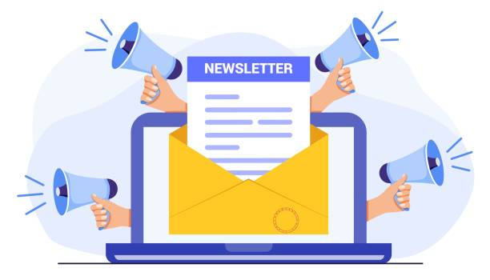
NEWSLETTER ADVERTISMENT
The NPACE newsletter is sent on the first Thursday of each month. All advertisements must be approved by NPACE. All ads will link to a URL of advertiser’s choice. Ads and links are due 7 business days before send.
Image Guidelines:
Banner Ad Image Size – 560x280px, JPEG
Box Ad Image Size – 300 x 150 px, JPEG
Video Ad – Submit video as MP4 file

Slide 22
COMPANY LANDING PAGE
Display Page Items to Submit:
Company logo
Company description (1,000 words or less)
Company website (URL link – up to 10 can be provided)
Company Social Media Accounts
Company Contact Info
Image/Video/Files Guidelines:
Logo Image Size – 600 x 300 px, submitted as JPEG or PNG
Video Ad – Submit video as MP4 file and/or link to YouTube/video platform
Files – PDF files only

Slide 23
LOGO ADVERTISMENT
Please submit company logos as 500 x 500px JPEG or PNG files

Slide 24

QUESTIONS?
Please direct any questions regarding this guide or your opportunity at NPACE to:
Josh Plotkin, NPACE COO
jplotkin@npace.org
774-279-4607
Emily Eddins, NPACE Business Development Coordinator
eeddins@npace.org
774-270-5445

